Slide 1


Mars China Forecasting – End to End
MCH Atlas Rollout
March 2008

Slide 2
Agenda
Current Solution
New (Post Atlas) Solution
Benefits
Open Questions
BW Introduction
CIP Recommendations

Slide 3
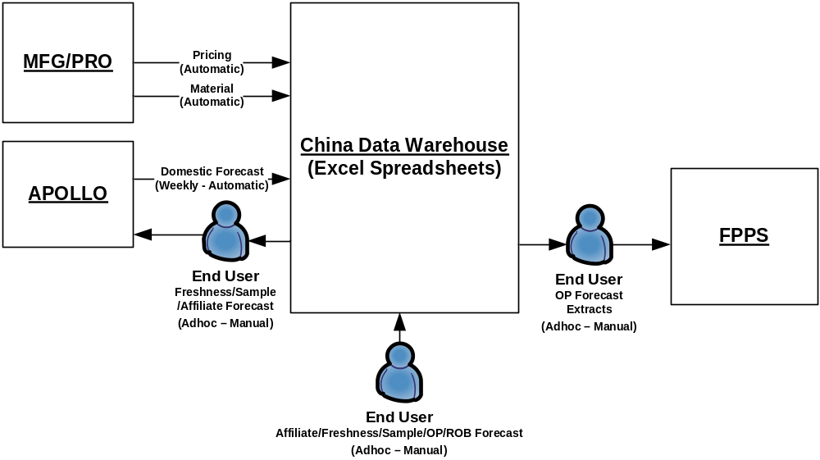
Current Solution

Slide 4
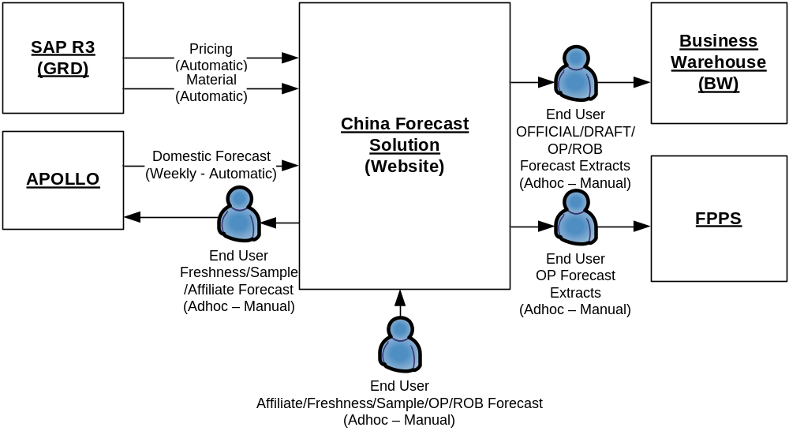
New (Post Atlas) Solution

Slide 5
Benefits of New Solution
  No reliance on Excel spreadsheets/macros
  Improved reliability/data integrity
  Tied to global SAP/GRD systems
  Flexible framework for future requirements
  Regionally supported solution
  Reusable for future rollouts
  Business Process remains unchanged

Slide 6
Open Questions
  How do you ensure DW Forecast is the same as Apollo and FPPS forecasts?
  How do you get customer destination information for Affiliate forecasts?
  Confirm what plant value in Domestic & Affiliate represents. (Source or Destination)
  What is FPPS requirement for Customer – is it different to BW Affiliate customer – if so, how do we reconcile the two?

Slide 7
BW Introduction
BW is separate system to Forecast Solution Environment – different to current solution.
BW Load Process
Reporting
Forecasts wont be reflected until following business day reporting

Slide 8
CIP
Automated Interfaces
Ability to manually load report forecasts during the day in BW
Security control within Forecast solution to limit user access to defined Types, Loads and Extracts

